Slide 1

ICIC BANK MANAGEMENT
Sujit Bawanthade

Slide 2
Introduction
Welcome to the presentation on our Bank Management System project. In today's session, we will explore the design and implementation of a comprehensive database system tailored for efficient management of banking operations. This system aims to streamline processes related to customer accounts, employee management, transactions, and more. Let's dive into the details of this innovative solution for enhancing banking efficiency and customer satisfaction

Slide 3
Problem Statement
The Bank wants to build a database for their customer and employees with all the details like creating an account in a bank type of account which helps the bank to retrieve the data with one click so they can find out the day-to-day updates easily on their database.
A customer wants to change his ATM PIN as his ATM has been lost due to some circumstances. Now he wants to change his PIN. So our task is to update that particular PIN in the database.

Slide 4
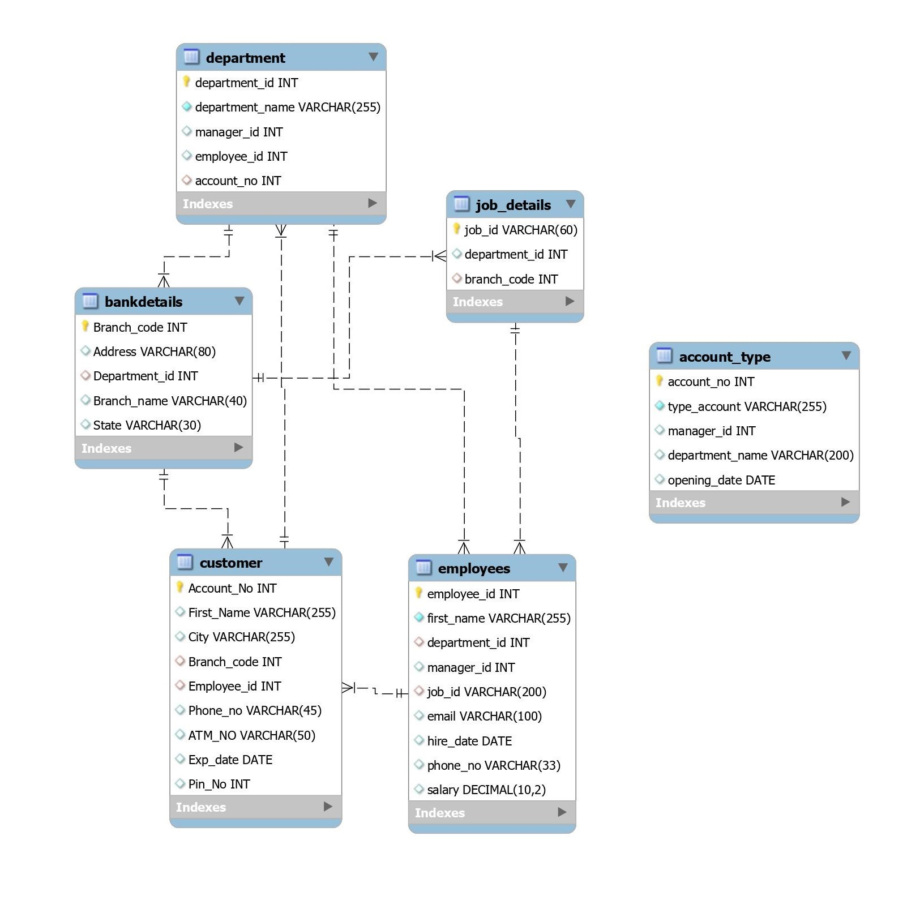
ER Model
Entities:
Bank_Details
Employees
Customer
Department
Job_Details
Account_Type

Slide 5
Relationships in the Bank Management System:
Bank Details: This entity represents the details of different bank branches, such as branch code, address, branch name, and state. Each bank branch can have multiple departments.
Employees: This entity stores information about bank employees, including employee ID, name, job title, department, manager ID, hire date, phone number, and salary. Employees are associated with departments and may have multiple job details.
Customer :The Customer entity contains details about bank customers, such as account number, first name, city, branch code, employee ID (assigned employee), phone number, ATM number, expiration date, and PIN number. Customers are associated with bank branches and employees.
Department: Departments within the bank are represented by this entity. It includes department ID, department name, manager ID, and branch code. Each department is managed by an employee and belongs to a specific bank branch.
Job Details: This entity stores job details for employees, including department ID, job ID, account number, department name, and opening date. It establishes the relationship between employees and their job roles within different departments.
Account Type: Account types offered by the bank are represented by this entity. It includes account number, account type, manager ID, department name, and opening date. It establishes the relationship between job details and account types.

Slide 6
Relationships
Bank Details - Department: One bank branch can have multiple departments, forming a one-to-many relationship.
Employees - Department: Multiple employees can belong to one department, forming a many-to-one relationship.
Employees – Job Details: One employee can have multiple job details, forming a one-to-many relationship.
Customer – Bank Details: Multiple customers can be associated with one bank branch, forming a many-to-one relationship.
Customer - Employees: Multiple customers can be served by one employee, forming a many-to-one relationship.
Job Details – Account Type: One job detail can be associated with multiple account types, forming a one-to-many relationship.

Slide 7
Proposed Solution
SQL(Structured Query Language) is a standardized Programming language used for managing and Manipulating relational databases. It provides a set of Commands or statements for interacting with databases, allowing users to store, retrieve, modify, and delete data.
With the help of SQL we will create the database and help the bank to retrieve the data in one click.

Slide 8
Proposed Solution
ne
Organize the Data in Database.
Establish Connection between Various Fields.
Creating Views to easily access the data.

Slide 9
Conclusion
SQL empowers banks to efficiently store, retrieve, analyze and manage financial data enabling critical banking operations, risk management ,compliance, customer relationship management, and decision-making processes.
SQL plays an significant role in the banking sector ,offering various applications and capabilities. With this system in place, banks can effectively handle tasks such as managing bank branches, tracking employee details, maintaining customer accounts, assigning employees to customers, and overseeing different job roles and account types

Slide 10
Future Scope
Enhanced Reporting and Analytics: Implementing advanced reporting and analytics capabilities can provide insights into customer behavior, employee performance, and overall bank operations. This could involve implementing data visualization tools, predictive analytics models, and business intelligence dashboards to aid decision-making processes.
Integration with Digital Banking Platforms: As digital banking continues to evolve, integrating the Bank Management System with digital banking platforms can offer customers seamless online banking experiences. This could include features such as account management, fund transfers, bill payments, and mobile banking functionalities.
Automation and Artificial Intelligence: Incorporating automation and artificial intelligence (AI) technologies can streamline routine tasks, improve process efficiency, and enhance customer service. Chatbots, automated customer support systems, and AI-driven fraud detection mechanisms are examples of potential automation initiatives.

Slide 11


